Slide 1



Slide 2
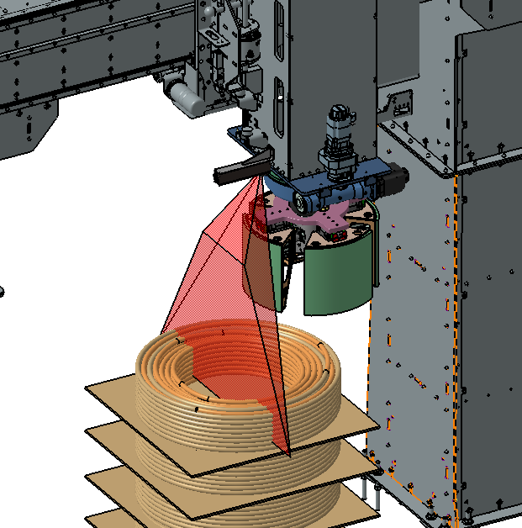

Project ROBOCOP
Full title | Cooperative robotic applications in Metalwork-Copper Industry
Call | Smart specialization strategy RIS3
Start date | 16/03/2020 | End date | 30/11/2023
Objective | Human-robot collaboration for autonomous loading-unloading of copper coils on Annealing Furnace
Business Impact | Pilot Case: Annealing Furnace 3 Workplace Ergonomics Improvement – Health & Safety Productivity increase Yield improvement Cost reduction Reduce Environmental Footprint Quality Improvement through Accuracy and Repeatability
Project Partner | Laboratory for Manufacturing Systems & Automation (LMS)
 | Budget | Funding
Halcor | 663.100 € | 431.015 €
LMS | 178.620 € | 178.620 €
Total Budget | 841.720 € | 609.635 €

Slide 3
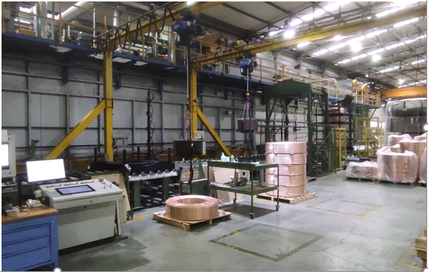
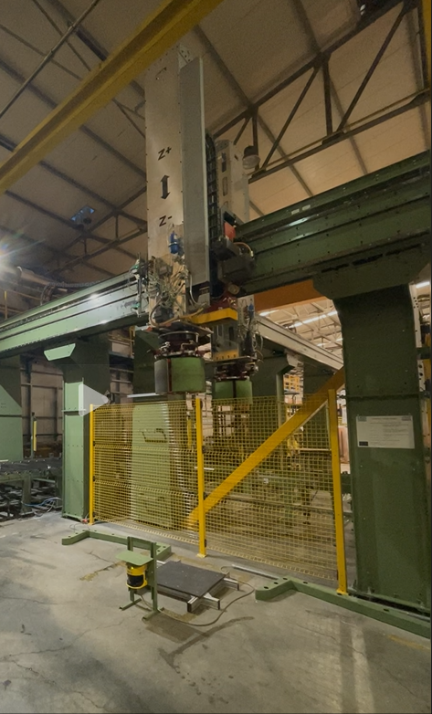
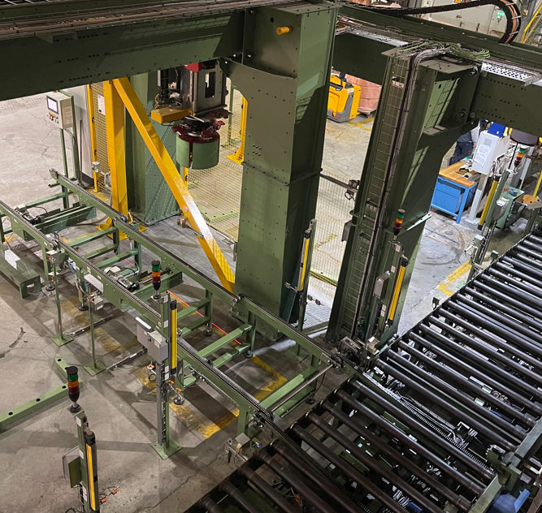
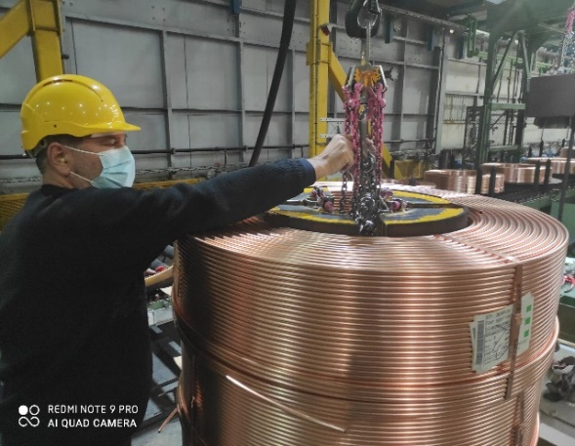
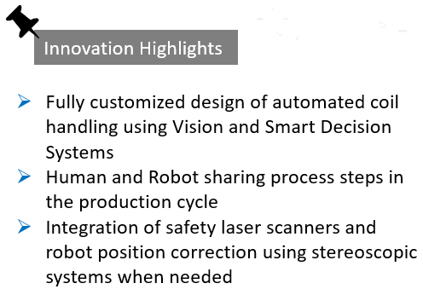
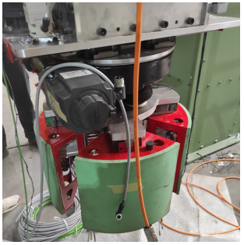
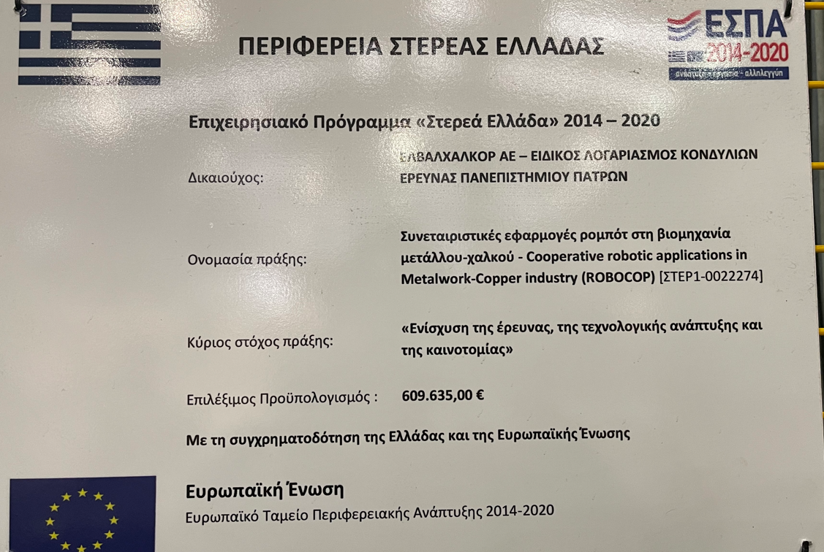
Installation and Pre-commissioning on Site - Milestones
Past
Now
3

Slide 4
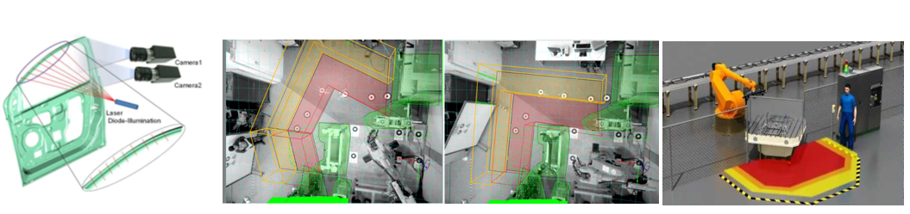

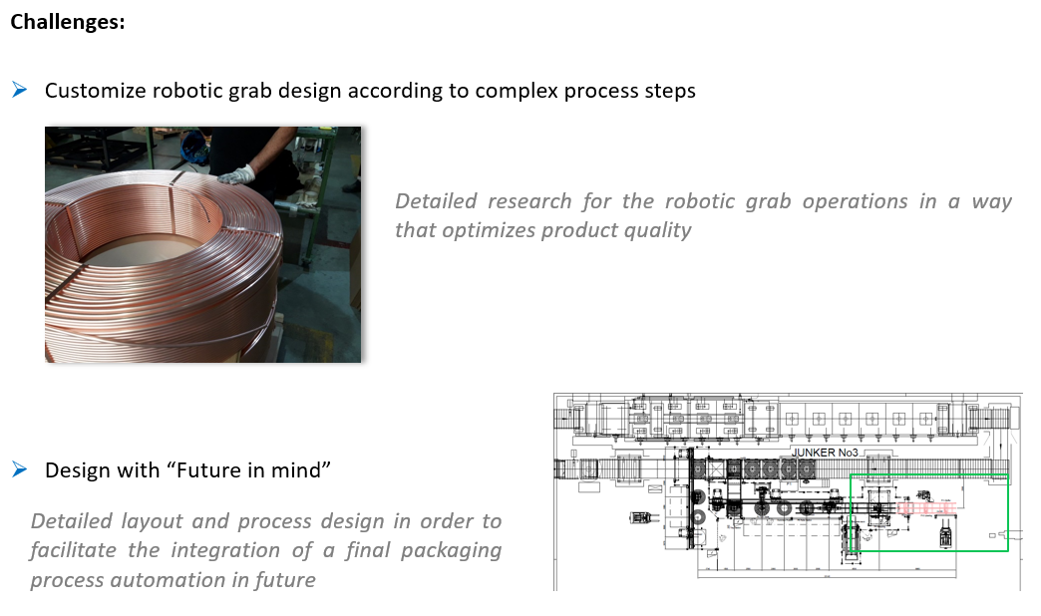
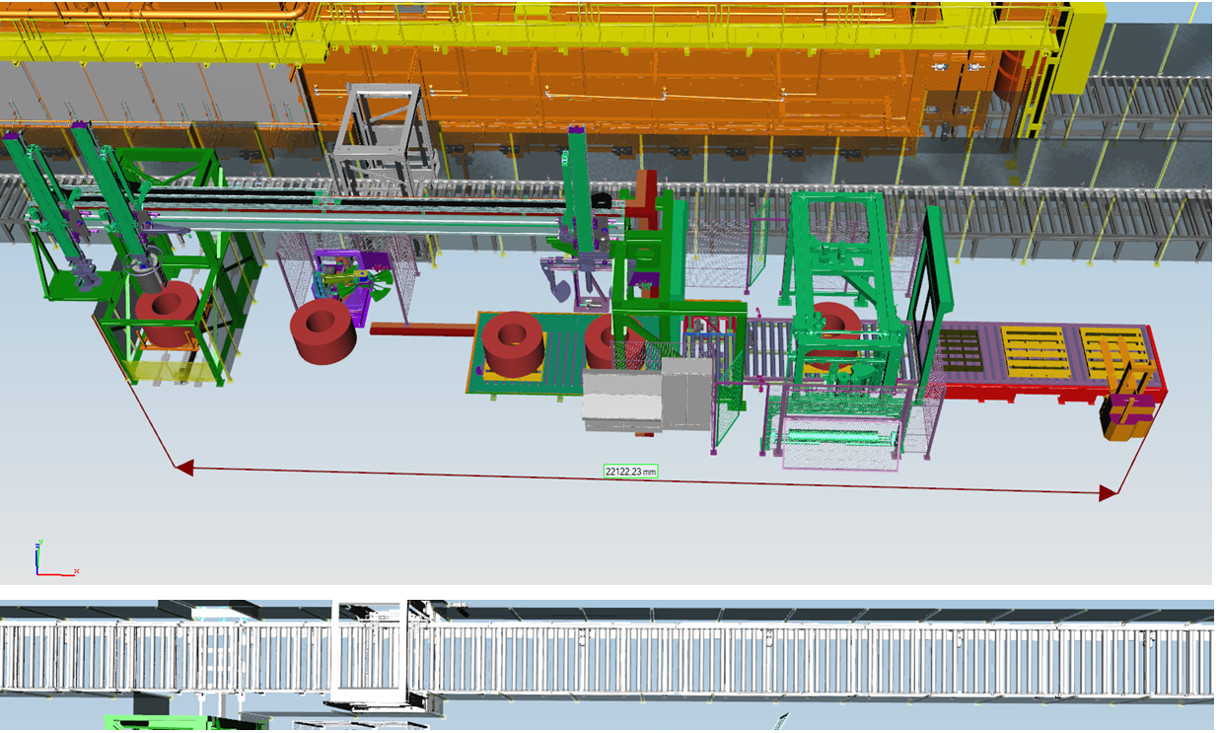
Project Highlights - Objectives
ROBO-COP Human-Robot Collaboration
Coil unloading
Coil packaging
Palletizing
Pallet packaging
4

Slide 5
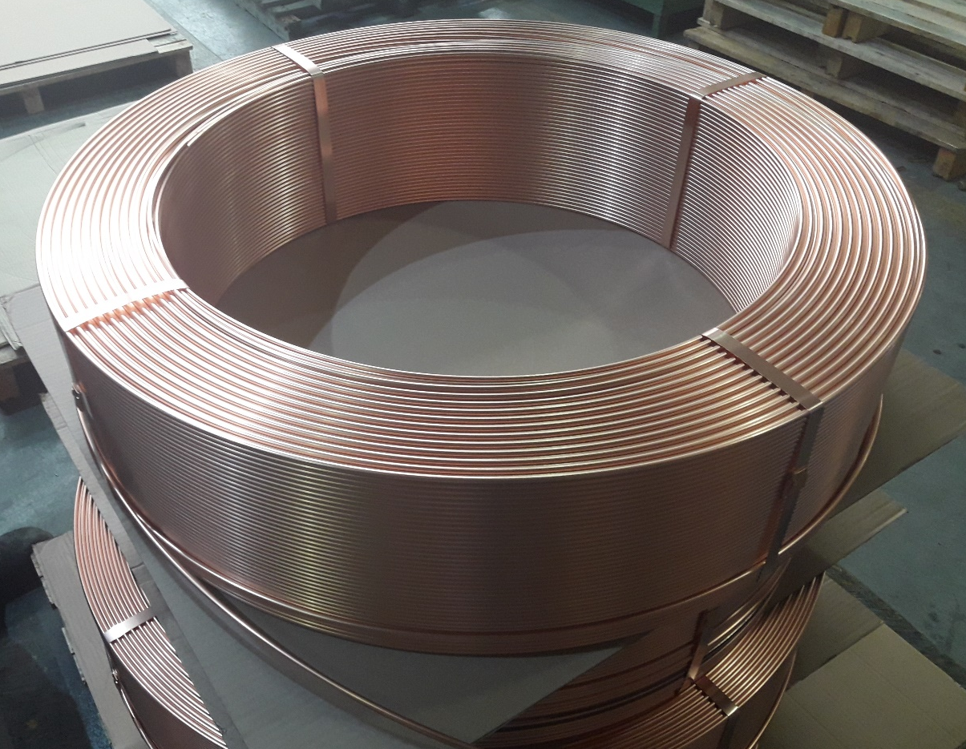
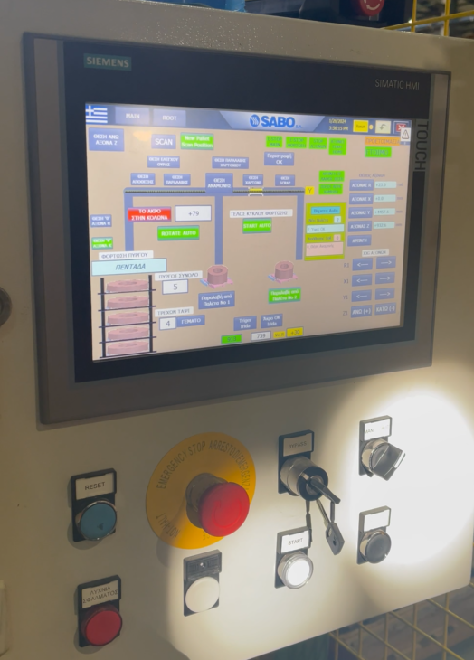
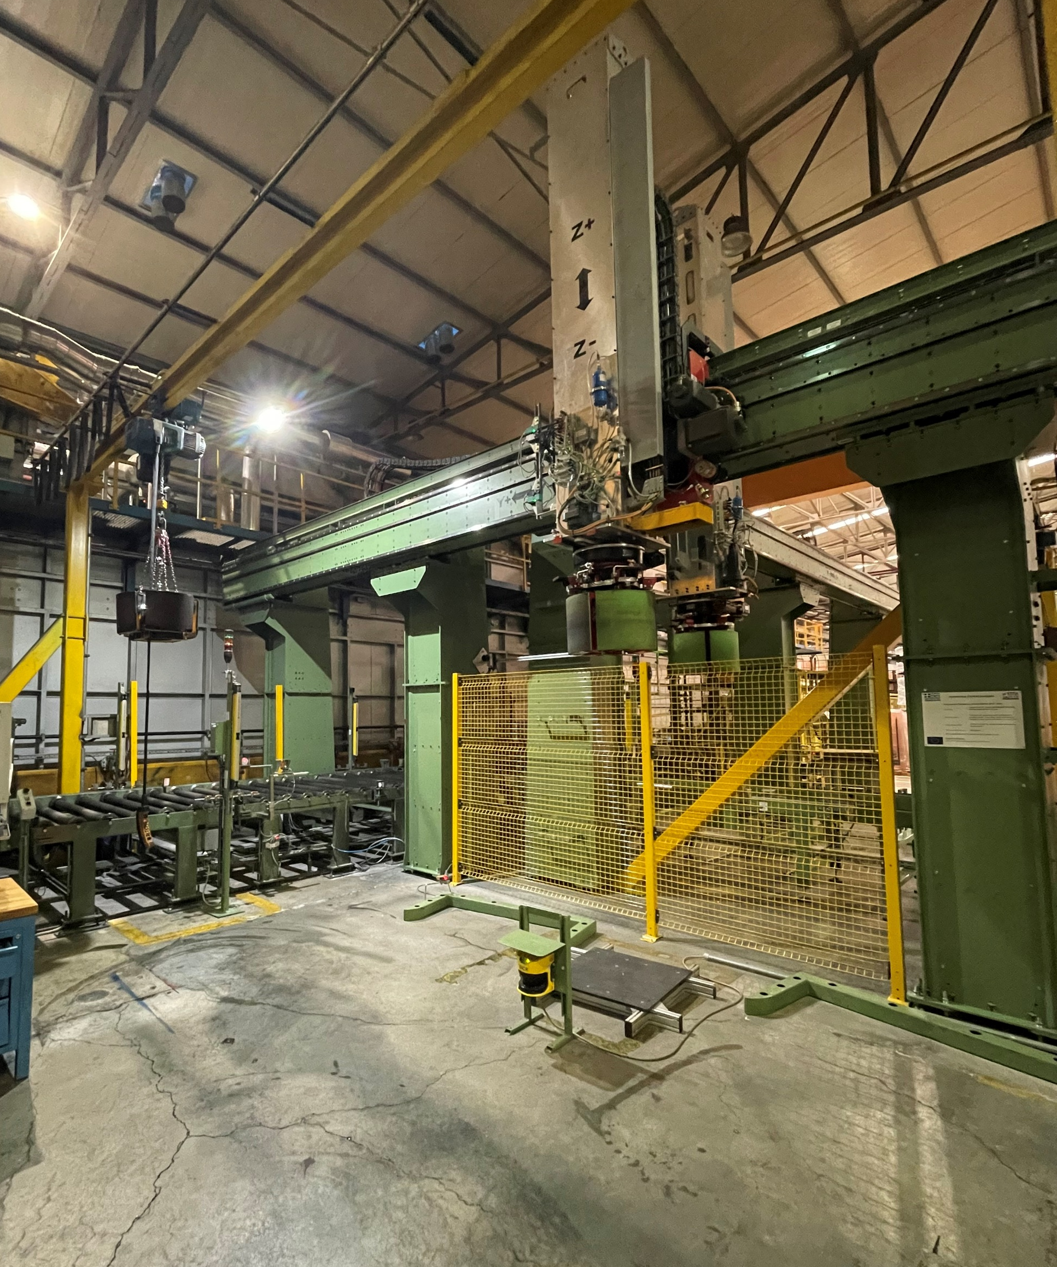
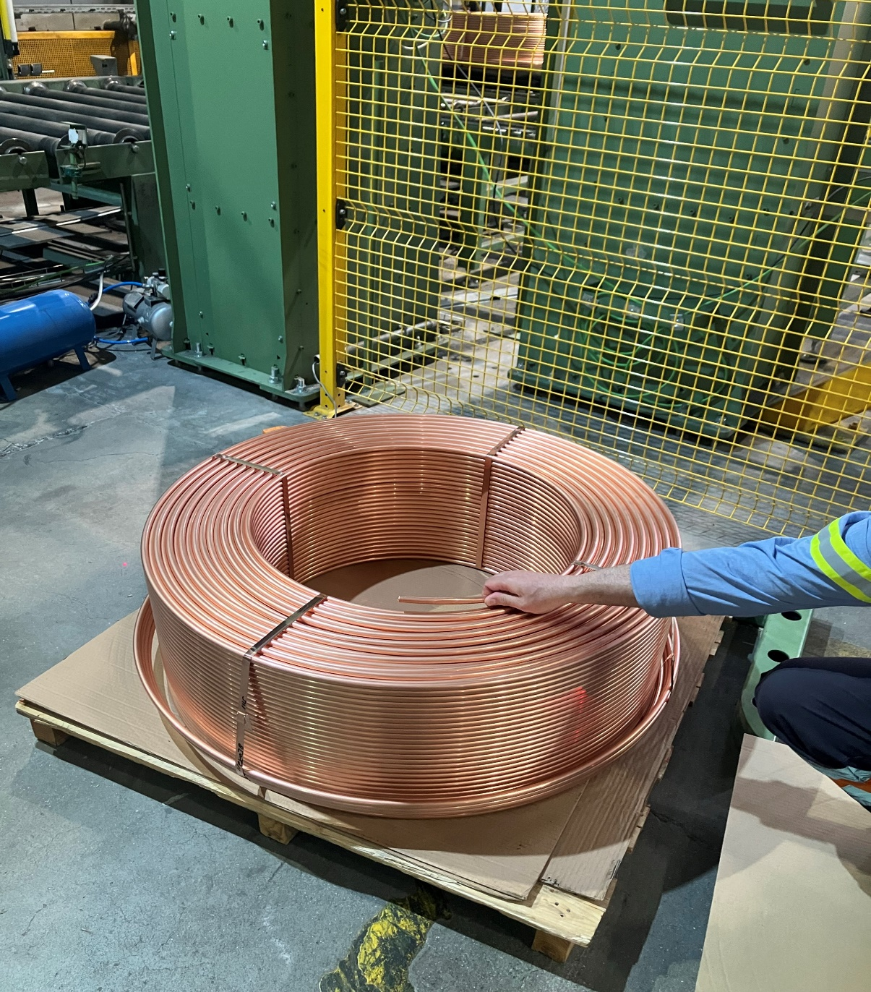
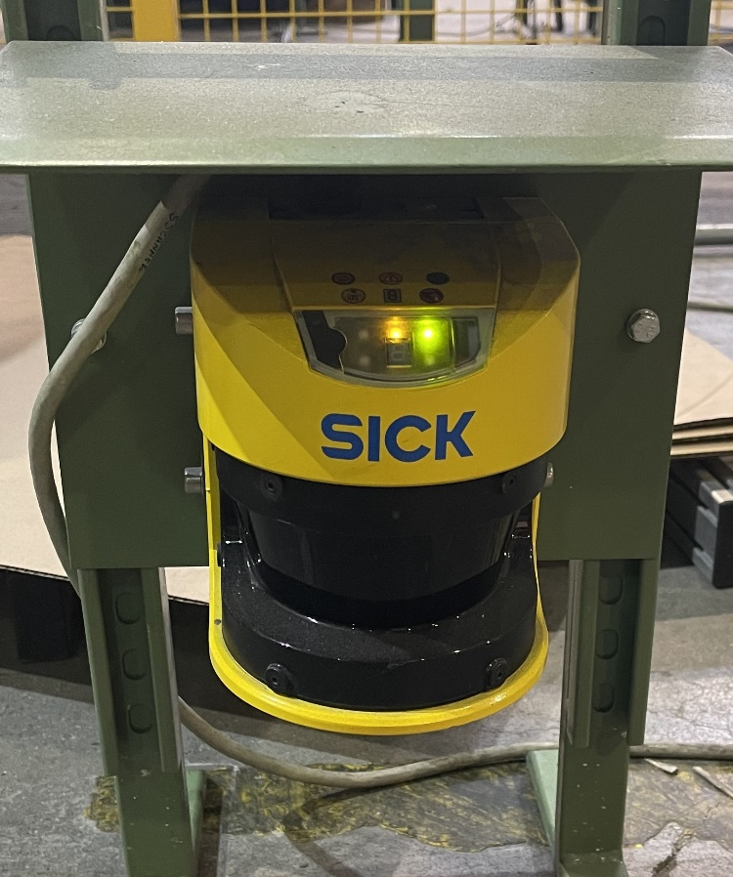
Packaging materials
Use of carton sheets between coils of the pallet
Use of copper stripes
Human – Robot Collaboration
Need of collaboration between the robot and the human in many cases.
Safety sensors installed
Collaboration case 1
-Collaboration case 2
-Collaboration Case 3
- Loading

Slide 6
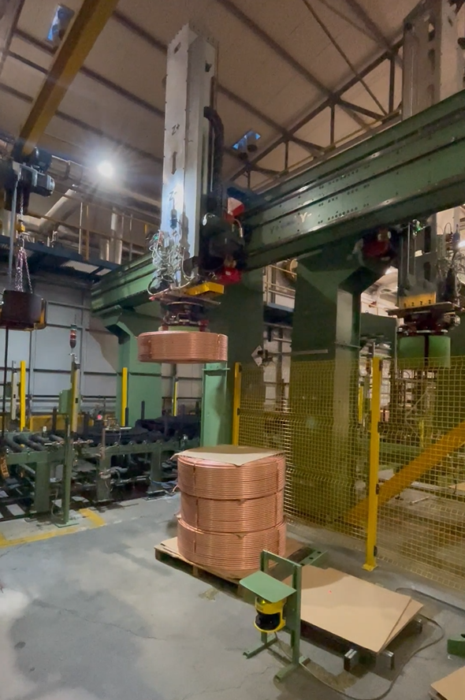
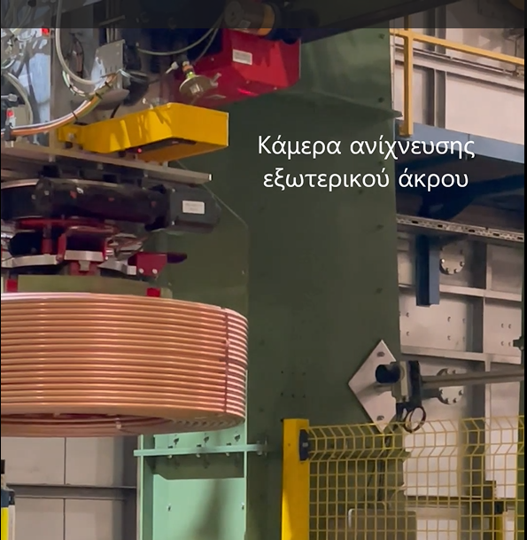
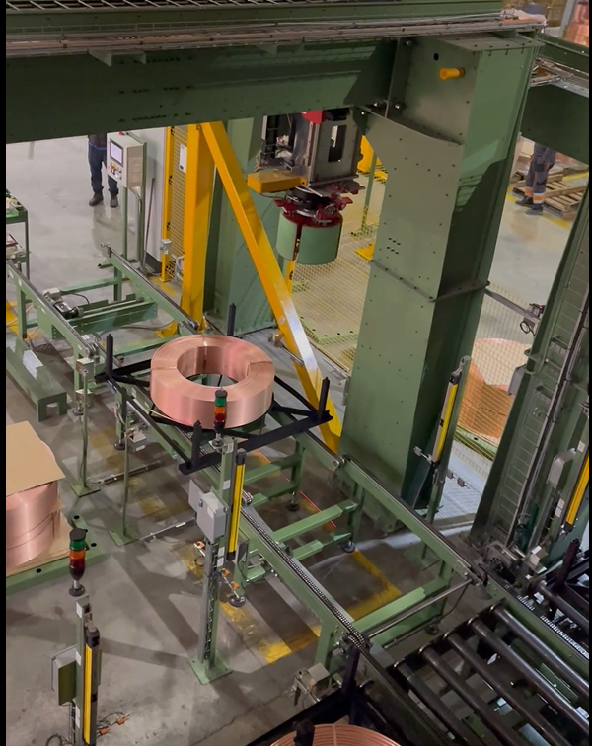
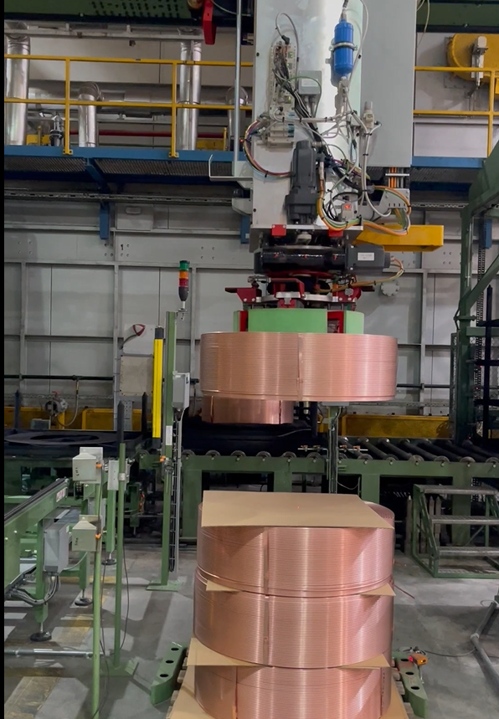
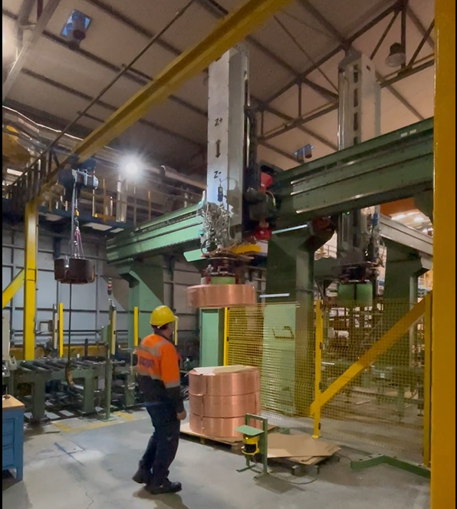
Operation Videos (Pilot Productions)
General Operation1

Slide 7
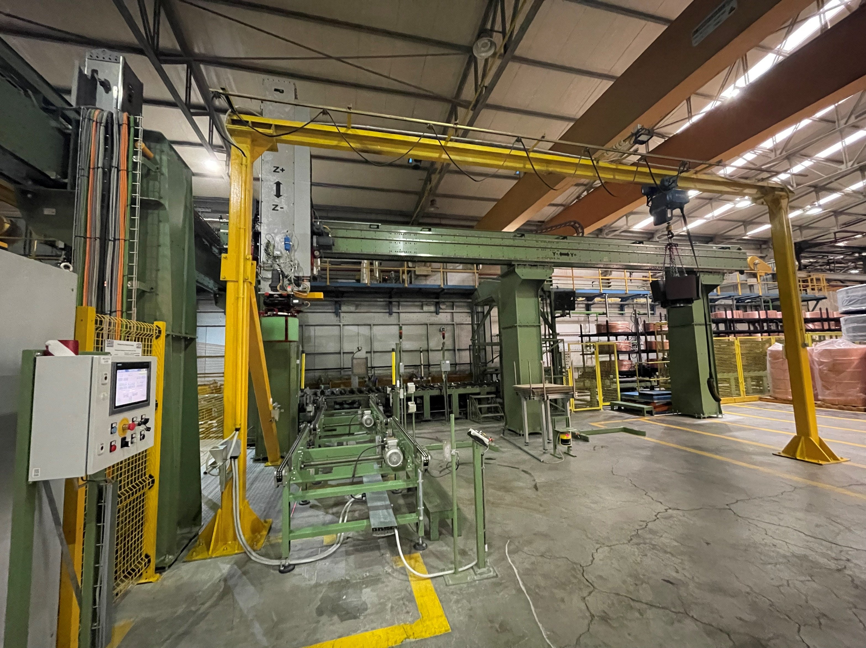

Final Technical Solution
Loading Station
Unloading Station

Slide 8
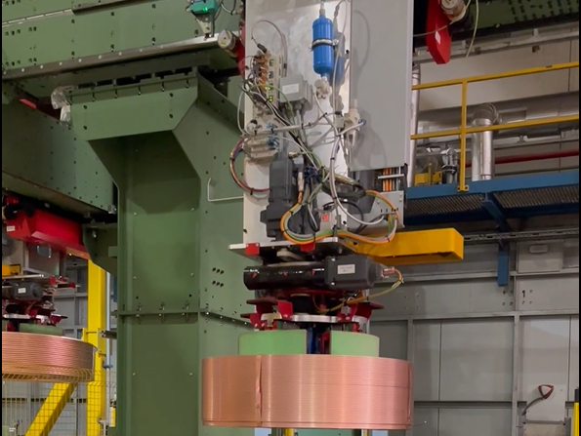
Results - Benefits
Workplace Ergonomics Improvement – Health & Safety
Upgrading plant copper tube production with the first implementation of a completed human-robot collaboration system
Halcor owns manufacturing and installations drawings for “turnkey” solutions of relative automations
Maintenance engages to support, maintain and improve next generation automation systems
System ready for implementation in other working centers
Cost Reduction
Industry-Academia collaboration on the production field
8

Slide 9



